Slide 1
Contribution History Log
Slide | Contributor | Date
7, 12 | Matthew | 10/26/2017
10-11 | Brandon | 10/26/2017
3-4 | Joseph | 10/26/2017
8-9 | Erik | 10/26/2017
5-6 | Kyle | 10/26/2017
13-14 | Evan | 10/26/2017

Slide 2

Brandon Jackson, Erik Culberson, Evan Bradley, Kyle Schrade,
Joseph Herkness, Matthew DeMott

Slide 3
User Story 15
As a Shopper, I can like a product so I can see it later and update my preferences.
Functional Requirements
36, 56, 59
Nonfunctional Requirements
4, 12, 13

Slide 4
User Story 16
As a Shopper, I can dislike a product so I can update my preferences.
Functional Requirements
37, 57, 59
Nonfunctional Requirements
4, 12

Slide 5
User Story 17
As a Shopper, I can view the liked products page so I can see the products I have liked.
Functional Requirements
54-56
Nonfunctional Requirements
1, 4, 14

Slide 6
User Story 18
As a Shopper, I can unsubscribe from a channel so I will no longer see that channel.
Functional Requirements
61
Nonfunctional Requirements
15

Slide 7
User Story 19
As a Shopper, I can follow another Shopper so I can see their profile.
Functional Requirements
63
Nonfunctional Requirements
16

Slide 8
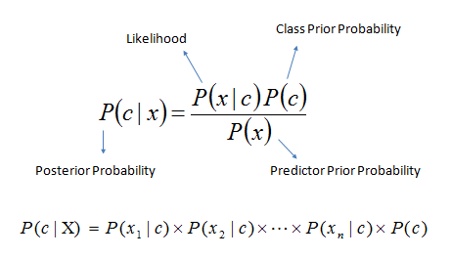
Suggestion Algorithm - Naive Bayes
Using tags from the clarifai API
Naive Bayes formula
Using tags as one way to “vote”

Slide 9
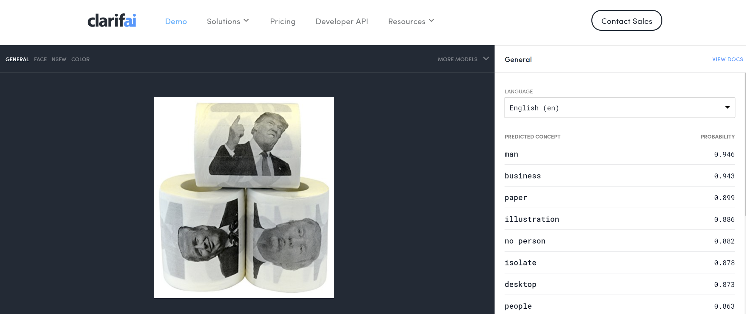

Slide 10
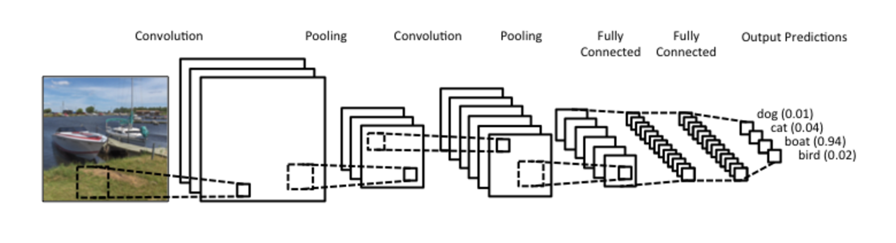
Suggestion Algorithm - CNN
Convolutional Neural Network Info Here

Slide 11
Suggestion Algorithm - Ensemble
Naive Bayes + Convolutional Neural Net = Final Prediction

Slide 12


Slide 13
Sprint 5 Objectives
Search for channels
Search for Shoppers
Stage 2 Of Suggestion Algorithm
Previous Product Arrow
Channels tab on profile
Following tab on profile
More Information page

Slide 14
Demo

Slide 15
Questions

